Slide 1
Fork/Join Framework

Slide 2
What you’ll learn
Concurrency vs Parallelism
IO Bound vs CPU Bound
Thread Pools 101
Divide & Conquer with Fork/Join Framework

Slide 3

Concurrency vs Parallelism
Concurrency - dealing with lots of things at once
Parallelism - doing lots of things at once

Slide 4
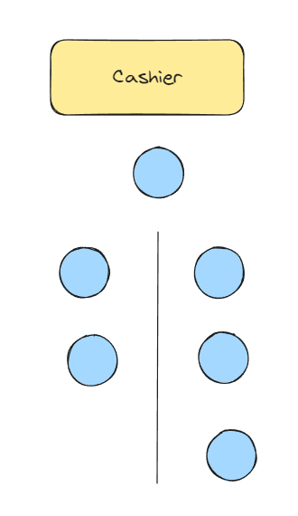
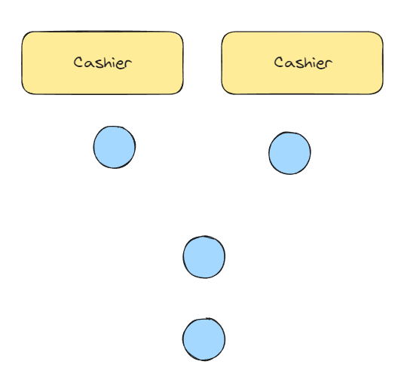
Concurrency vs Parallelism
Concurrency
Parallelism

Slide 5
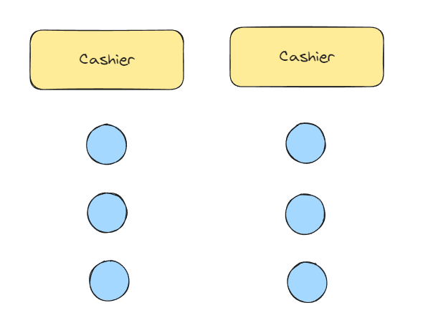
Concurrency vs Parallelism
Concurrent & Parallel

Slide 6
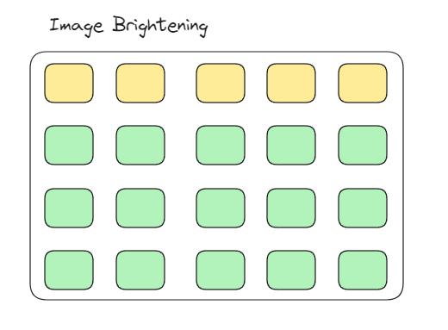

Where concurrency doesn’t help
Notes:
Let’s say we want to increase pixel value by 1

Slide 7
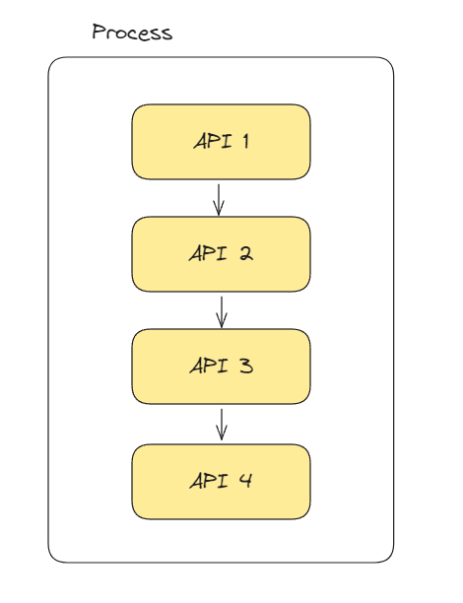
When concurrency helps
Need different info from different APIs
Process blocks until API returns
API calls runs sequentially
* If order matters (e.g. API 3 depends on output of API 2) then those should not be run concurrently
Notes:
GUIs do this to allow user to interact with the GUI while something is executing in background

Slide 8
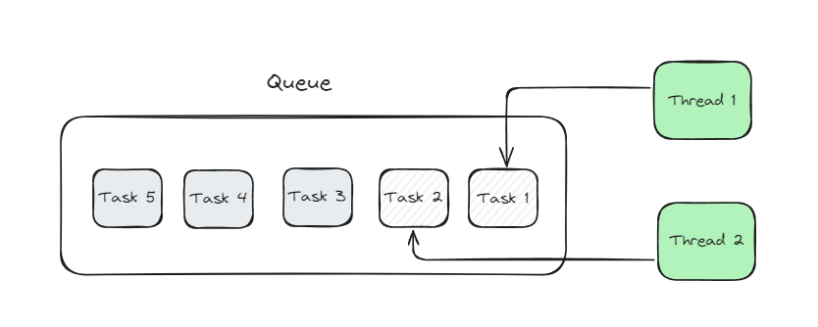
Thread Pools
Notes:
Why not just spin up a thread everytime? Memory issues

Slide 9
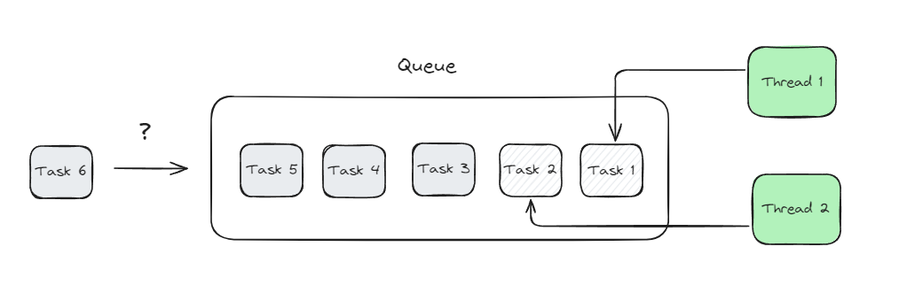
Thread Pools
Notes:
What happens when the queue is full and a task gets submitted to the threadpool?

Slide 10
Thread Pools
Non-blocking Queue →
Blocking Queue →
OOM Error
RejectedExecutionException

Slide 11
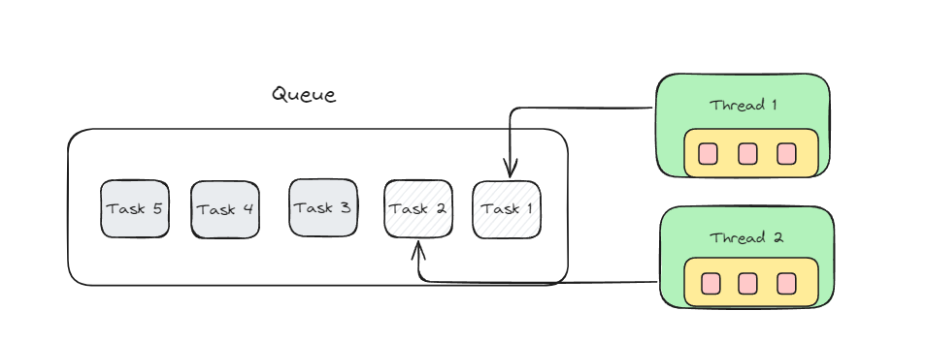
ForkJoinPool
An implementation of the ExecutorService interface
Allows for work stealing (from other thread’s deque)
Great for divide & conquer tasks
deque containing subtasks

Slide 12
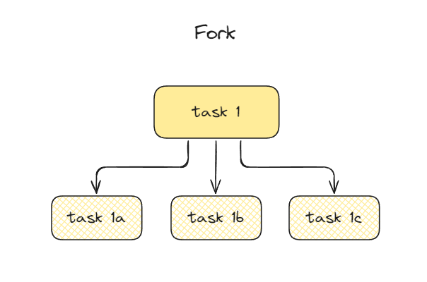
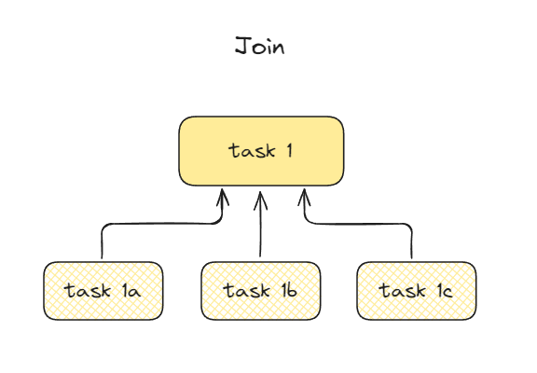
Fork & Join

Slide 13
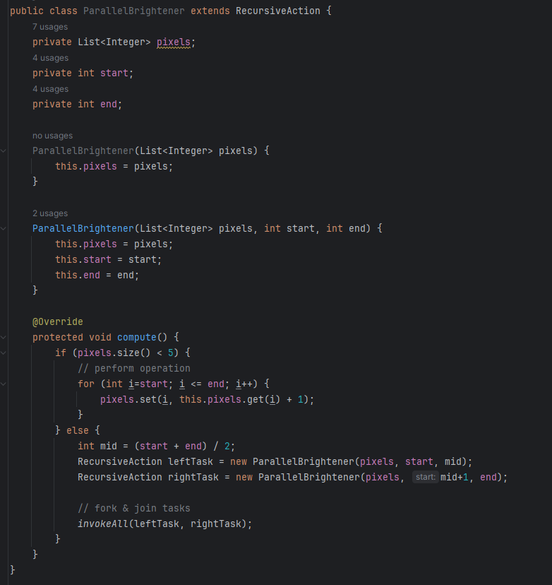
Divide & Conquer
RecursiveTask → Returns Values
RecursiveAction → Returns nothing
Here, it only forks
Notes:
RecursiveTask forks and joins
RecursiveAction only forks

Slide 14
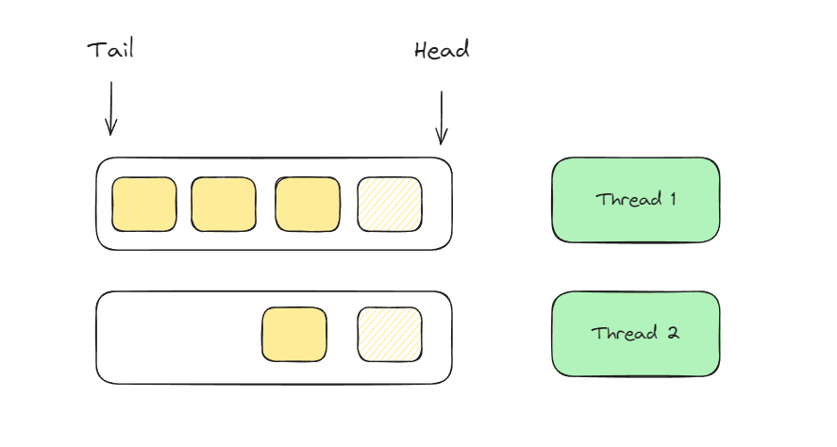
Work Stealing

Slide 15
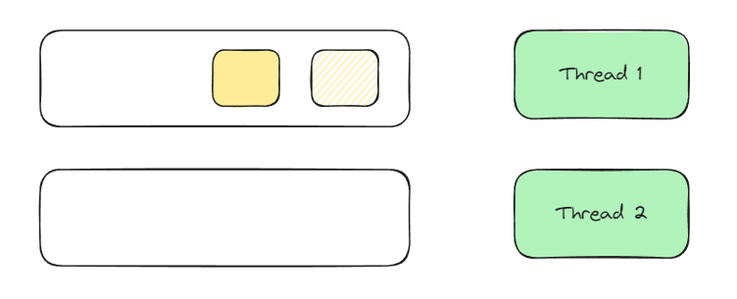
Work Stealing

Slide 16
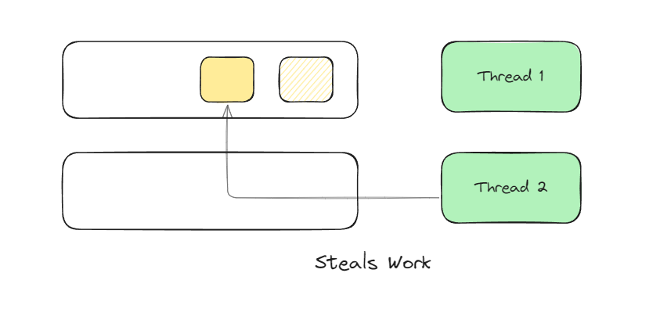
Work Stealing

Slide 17
What does the ForkJoinPool solve?
Utilizing multi-core systems
Idle threads
Work stealing allows idle threads to take work from the tail of another thread’s deque
This allows for faster & more efficient computation

Slide 18
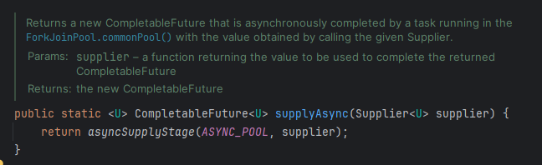
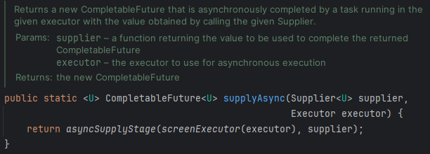
CompletableFuture
Runs with ForkJoinPool by default
If device doesn’t support parallelism then it falls back to ThreadPerTaskExecutor (spins up new threads and run them)
You can set where it runs if you need more control over the execution

Slide 19
Key Takeaways
IO-bound vs CPU-bound
Thread pools help with performance
Fork Join Pool utilizes multi-core hardware
Completable Futures run with ForkJoinPool by default
You should change the pool if you want more control on its execution

